Slide 1
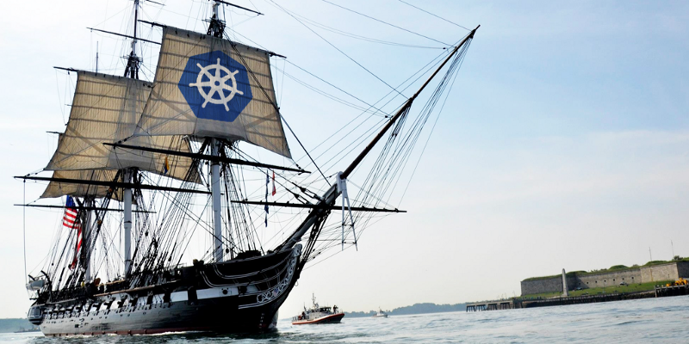
Using Kubernetes
Day 1
Nesia Amit

Slide 2
Agenda
Microservices Architecture
Microservices Architecture
What is Kubernetes?
Kubernetes Basics

Slide 3
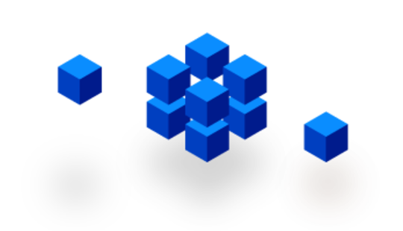
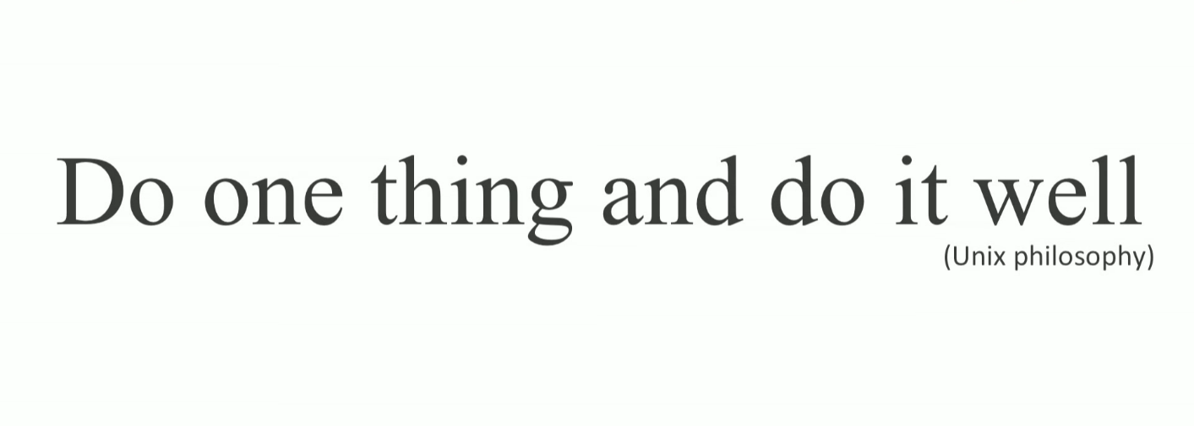
Microservices

Slide 4
Typical MVC Application
User Interface
What if the application keeps growing?
Business-Logic
Data Layer
DB

Slide 5
Typical MVC Application
User Interface
FileView
OrderView
AccountView
ProjectView
Adding more and more functionality until…
- render
- render
- render
- render
Business-Logic
FileLoader
AcctController
Auth
OrderController
ProjectController
LoginController
createOrder
showOrder
- account
- user
- permissions
createOrder
showOrder
show
create
- user
Data Layer
File
Order
Account
Permissions
Project
path
content
type
account
id
user
role
permissions
name
orders
User
username
password
FS
DB

Slide 6
Monolithic Architecture
User Interface
FileView
OrderView
AccountView
ProjectView
It becomes a massive monolith that is almost impossible to maintain and eats way too much CPU and RAM.
- render
- render
- render
- render
Business-Logic
FileLoader
AcctController
Auth
OrderController
ProjectController
LoginController
createOrder
showOrder
- account
- user
- permissions
createOrder
showOrder
show
create
- user
Data Layer
File
Order
Account
Permissions
Project
path
content
type
account
id
user
role
permissions
name
orders
User
username
password
FS
DB

Slide 7
Monolithics Limitations
Application too large and complex to fully understand
Impact of a change usually not predictable
Bug in one module (e.g. memory leak) could potentially bring down the entire application
On each update – need to redeploy the entire application.
Barrier in adopting new technologies or frameworks
Size of application increase build time and slows down start-up time.
Continues deployment is difficult.

Slide 8
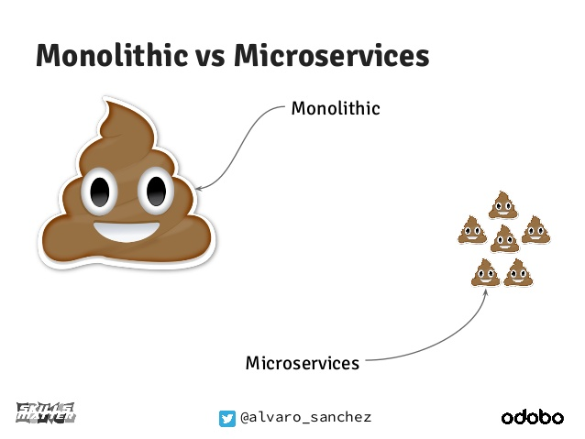

Slide 9
Split the application into smaller chunks
User Interface
Business-Logic
Data Layer
DB
FS

Slide 10
Split the application into smaller chunks
File-Service
User Interface
Mgmt
Orders-Service
Account-Service
Auth
Notofication-Service
Payment-Service
FS
DB
DB
DB
DB

Slide 11
Split the application into smaller chunks
User Interface
http
http
http
File-Service
http
Mgmt
http
Orders-Service
http
Auth
Notofication-Service
Account-Service
Payment-Service
FS
DB
DB
DB
DB

Slide 12
Host-centric Infrastructure
User Interface
http
=
The old way to deploy applications
heavyweight, non-portable, Relies on OS package manager
http
http
File-Service
http
Mgmt
http
Orders-Service
http
Auth
Notofication-Service
Account-Service
Payment-Service
Binaries/Libraries
libyaml
libxslt
libicu
Ruby
Node
npm
Java
FS
DB
DB
DB
DB
libssl
libxml
libpq
Mysql-Client
Redis-tools
Host Operating System Kernel

Slide 13

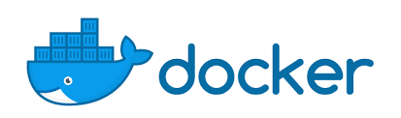
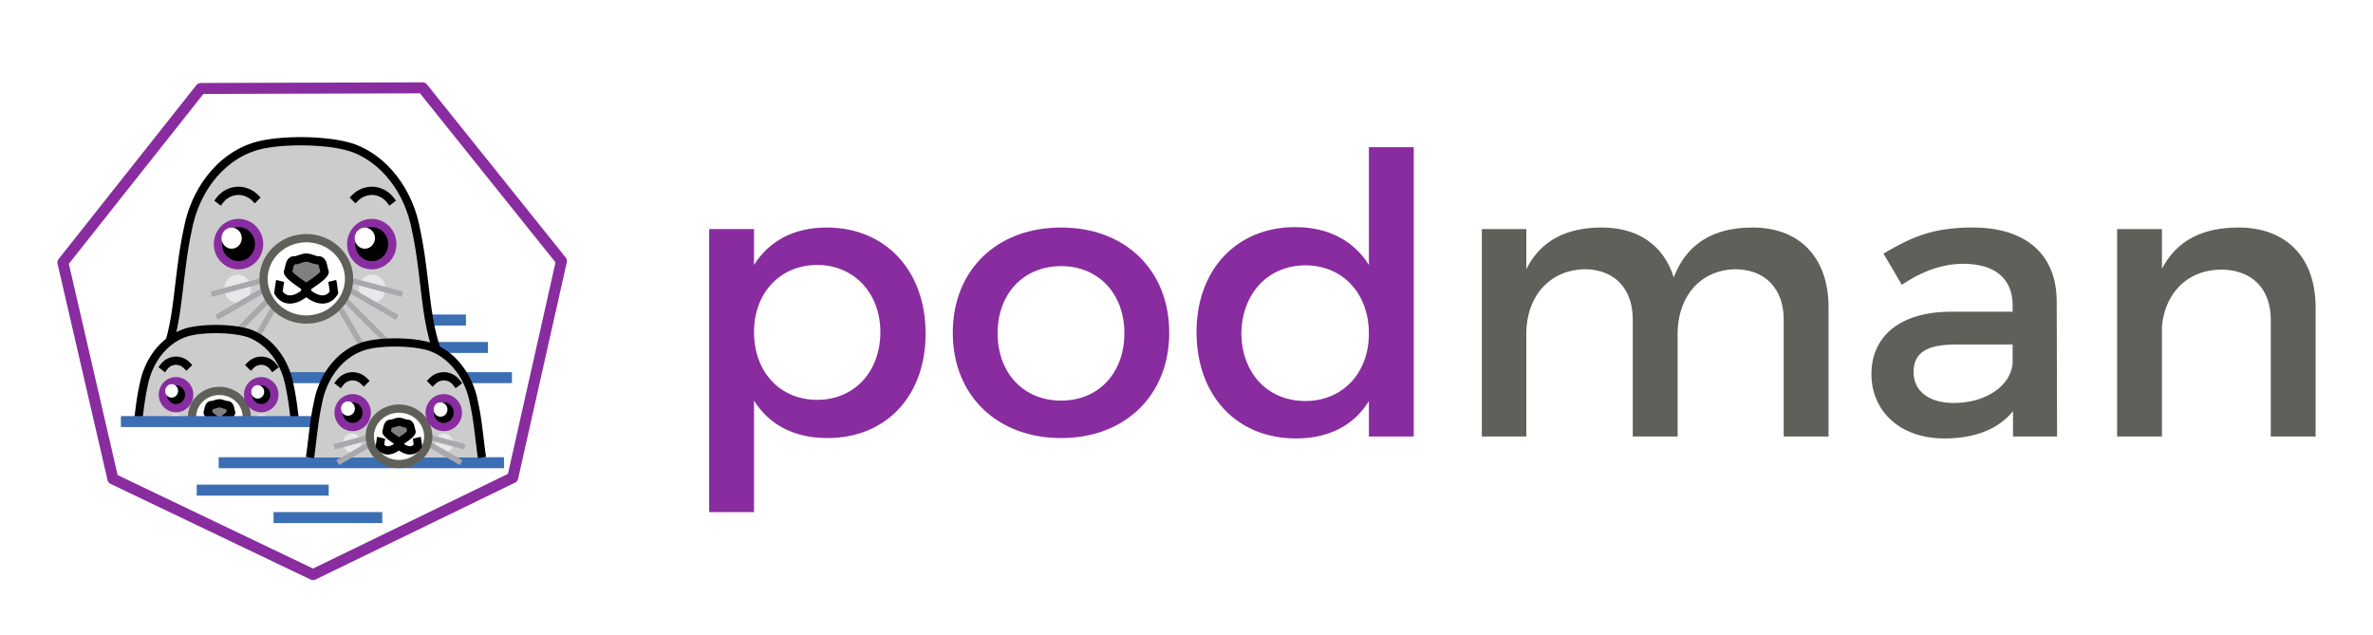
Container-centric Infrastructure
User Interface
Bin/Lib
Mgmt
http
http
Bin/Lib
=
The new way to deploy applications
Small and fast, portable, Uses OS-level virtualization
File-Service
http
http
http
Bin/Lib
Auth
Orders-Service
Bin/Lib
Bin/Lib
Account-Service
Payment-Service
Bin/Lib
Bin/Lib
Docker Engine or (podman/rkt)
Binaries/Libraries
Host Operating System Kernel

Slide 14
Containers Benefits
Loosely coupled, distributed, elastic, liberated micro-services
Application-centric management
Environmental consistency across development, testing, and production
Continuous development, integration, and deployment
Resource isolation

Slide 15
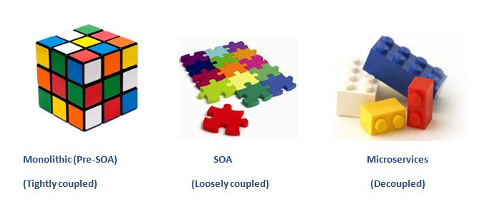
Monolithic – Service Oriented - Microservices

Slide 16
Agenda
A microservice is an isolated, loosely-coupled unit of development that works on a single concern.
Microservices Architecture
What is Kubernetes?
What is Kubernetes?
Kubernetes Basics

Slide 17
First, Microservices Challenges…

Slide 18

VM#3
VM#1
VM#2

Slide 19
Challenge 1:
Auto Deploy
Auto Scale
VM#3
VM#1
VM#2

Slide 20
Challenge 2:
Load Balancing
VM#3
VM#1
VM#2

Slide 21
Challenge 3:
Service Discovery
red:1880
VM#3
VM#1
VM#2

Slide 22
Challenge 4:
Zero Downtime deploys
VM#3
VM#1
VM#2

Slide 23
Challenge 5:
Health Checks
VM#3
VM#1
VM#2

Slide 24
Challenge 6:
Distribute Configuration and Secrets
VM#3
VM#1
VM#2

Slide 25
Challenge 7:
Storage Management
VM#3
VM#1
VM#2

Slide 26
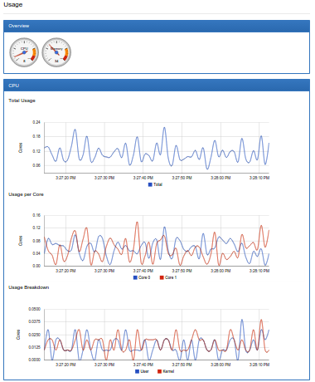
Challenge 8:
Monitoring Resources
VM#3
VM#1
VM#2

Slide 27
How can we meet the challenges?

Slide 28
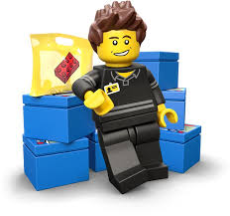
Containers Orchestrator
The main players:
Kubernetes
AWS ECS
Docker Swarm
Kubernetes has the largest community and is the most popular by a big margin

Slide 29
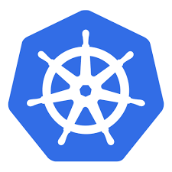
Kubernetes (aka. K8s)
Kubernetes is an open-source started in 2014 by Google.
Community includes Google, Red Hat, and over 3000 authors. (Source: k8s github )
The name Kubernetes originates from Greek, meaning helmsman

Slide 30
Agenda
A microservice is an isolated, loosely-coupled unit of development that works on a single concern.
Microservices Architecture
Kubernetes is an open-source platform designed to automate deploying, scaling, and operating application containers.
What is Kubernetes?
Kubernetes Basics
Kubernetes Basics

Slide 31
Pod - the basic building block of Kubernetes
IP address
10.10.10.2
Containerized app
VM#3
VM#1
VM#2

Slide 32
Pod
A Pod represents a unit of deployment:
a single instance of an application in Kubernetes
The Pod might consist of either a single container or a small number of containers that are tightly coupled and that share resources.

Slide 33
Master
Pod
Kube-apiserver
etcd
Kube-scheduler
Kube-controller-manager
Docker
kublet
kublet
Docker
Node
Node Processes
Kubernetes Cluster
kublet
Docker

Slide 34

Kubernetes Cluster

Slide 35

kubectl create deployment my-app …
Master
Node#3
Docker
kublet
Node#1
kublet
Docker
Node#2
Kubernetes Cluster
kublet
Docker

Slide 36
Working with kubectl Imperative Commands
Deploy and Explore an Application (Lab: task-1)
# create a single pod with nginx container
$ kubectl run my-app --image=nginx
# list all pods
$ kubectl get po
# stream pod logs (stdout)
$ kubectl logs –f my-app
# run command in a pod
$ kubectl exec –it my-app bash
# forward port 80 of pod to port 10080 on your local machine
$ kubectl port-forward my-app 10080:80
# show more details about po including all events
$ kubectl describe po my-app

Slide 37
Pod
Pods are designed as relatively ephemeral, disposable entities.
Pods are managed in Kubernetes via Controllers

Slide 38
Controller
A Controller can create and manage multiple Pods for you, handling replication and rollout and providing self-healing capabilities at cluster scope.
Some examples of Controllers:
Deployment
StatefulSet
DaemonSet

Slide 39
Master
Pod
Deployment
D
D
D
Docker
kublet
kublet
Docker
Node
Node Processes
Kubernetes Cluster
kublet
Docker

Slide 40
kubectl create deploy my-app …
D
Master
Node#3
Docker
kublet
Node#1
kublet
Docker
Node#2
Kubernetes Cluster
kublet
Docker

Slide 41
kubectl expose deploy …
10.30.0.2:5672
10.40.0.2:80
D
D
Master
10.97.14.200:5673
10.105.128.60:8080
Node#3
S
S
kublet
Docker
Node#1
kublet
Docker
10.32.0.3:5672
10.43.0.2:80
Node#2
Kubernetes Cluster
kublet
Docker

Slide 42
Service
A Service routes traffic across a set of Pods
The set of Pods targeted by a Service is usually determined by a LabelSelector (selector: app …)
A Service is an abstraction that allow pods to die and replicate in Kubernetes without impacting your application.
Discovery and routing among Pods is handled by Kubernetes Services.

Slide 43
Working with kubectl Imperative Commands
Expose and Scale your Application (Lab: task-2)
# Create a service for my-app deployment, on port 80 and connects to the containers on port 8000.
$ kubectl expose deployment my-app --port=80 --target-port=8000
# List all services
$ kubectl get svc
# List pods and show all labels as the last column
$ kubectl get po --show-labels
# Scale a deployment named 'foo' to 3.
$ kubectl scale deploy my-app --replicas=3

Slide 44
Agenda
A microservice is an isolated, loosely-coupled unit of development that works on a single concern.
Microservices Architecture
Kubernetes is an open-source platform designed to automate deploying, scaling, and operating application containers.
What is Kubernetes?
Using kubectl imperative commands to Deploy, Explore, Expose, Scale your Application
Kubernetes Basics

